Slide 1
POLITECNICO DI BARI
DIPARTIMENTO DI INGEGNERIA ELETTRICA E DELL’INFORMAZIONE
LAUREA MAGISTRALE IN INGEGNERIA DELL’AUTOMAZIONE
APPLIED MECHANICS – FUNCTIONAL DESIGN
Prof. Eng. Massimo Mario Foglia
TRANSITION FROM PARALLEL GRIPPER TO ADAPTIVE GRIPPER: DESIGN AND 3D SIMULATIONS
Students:
Francesco Di Chio
Nicola Saltarelli
Francesco Stasi

Slide 2




OVERVIEW
STATE OF THE ART
3D MODELING
Creation of a preliminary sketch of the grippers, followed by an analysis to calculate the degrees of freedom and a displacement analysis using MATLAB.
Grip simulations under various operating conditions using SolidWorks Motion, followed by MATLAB processing to generate contact force graphs.
Collection of material to understand the context and existing solutions in the project's field of study.
Creation of detailed geometries for the gripper components, with attention to dimensions and materials, using SolidWorks, followed by the assembly phase.
DESIGN
EXPERIMENTAL PHASE

Slide 3
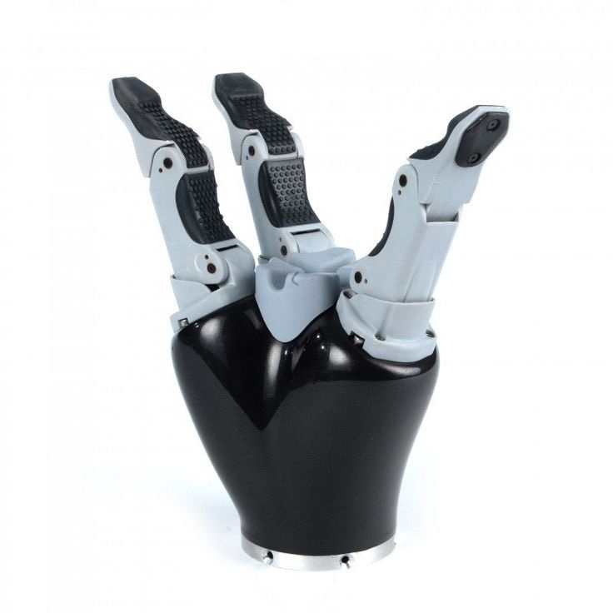
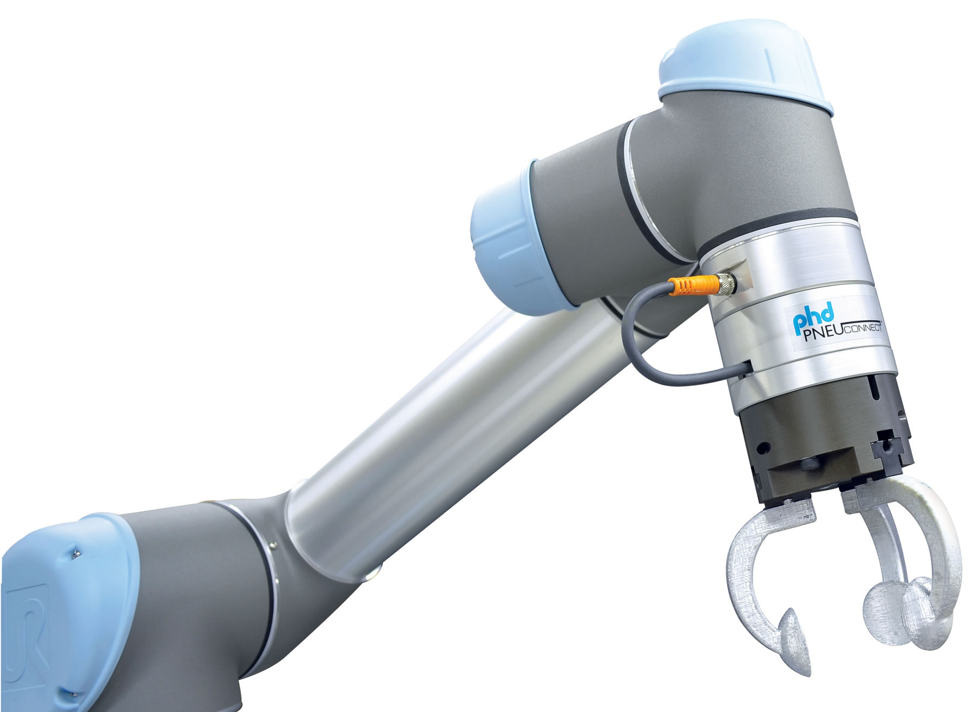
STATE OF THE ART
DESIGN
3D MODELING
EXPERIMENTAL PHASE
WHAT IS A ROBOTIC GRIPPER?
‘’Grippers are subsystems of handling mechanisms which provide temporary contact with the object to be grasped. They ensure the position and orientation when carrying and mating the object to the handling equipment. Prehension is achieved by force producing and form matching elements. The term “gripper” is also used in cases where no actual grasping, but rather holding of the object.’’¹
¹G.J. Monkman, Robot Grippers (Weinheim: Wiley-VCH, 2007)

Slide 4
STATE OF THE ART
DESIGN
3D MODELING
EXPERIMENTAL PHASE
CLASSIFICATION
Configuration-based
Number of fingers
Shape of fingers
Actuation-based
Electric actuation
Magnetic actuation
Vacuum grippers
Stiffness-based
Rigid grippers
Soft grippers
Application-based
Surgical application
Assistive application
Industrial application

Slide 5
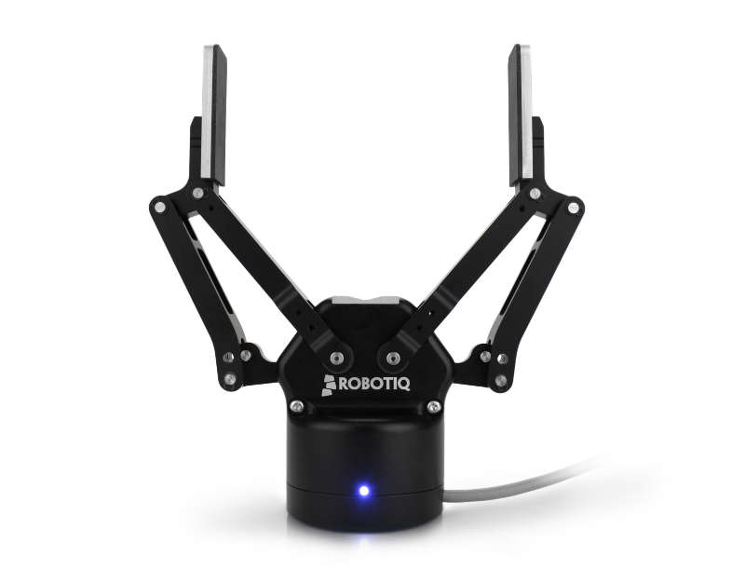
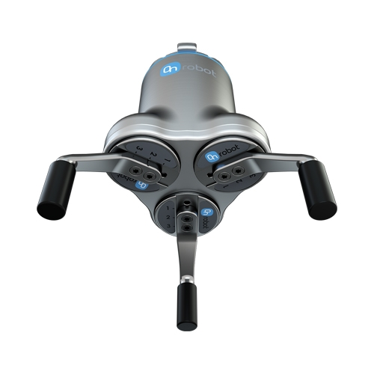
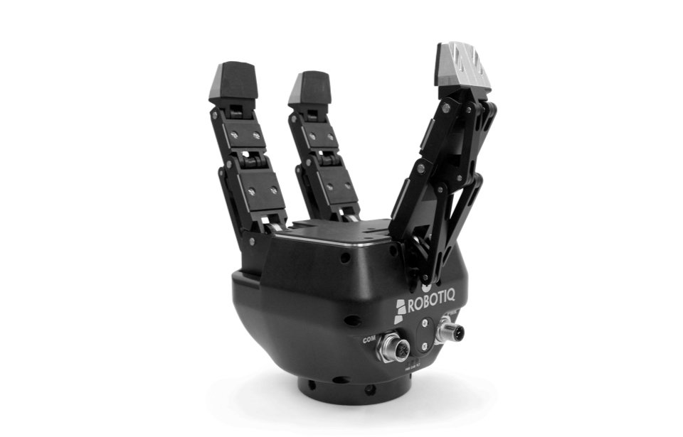
STATE OF THE ART
DESIGN
3D MODELING
EXPERIMENTAL PHASE
CLASSIFICATION
Application-based
Surgical application
Assistive application
Industrial application
Configuration-based
Number of fingers
Shape of fingers
Figure 1: Paralel gripper with 2 fingers.
Figure 3: Parallel gripper with 3 fingers.
Figure 2: Adaptive gripper with 3 fingers.
Actuation-based
Electric actuation
Magnetic actuation
Vacuum grippers
Stiffness-based
Rigid grippers
Soft grippers

Slide 6
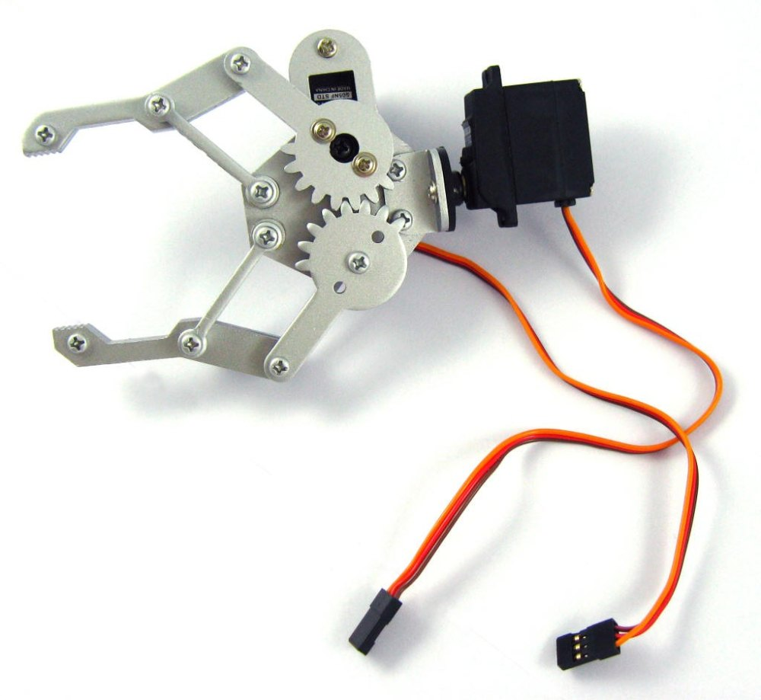
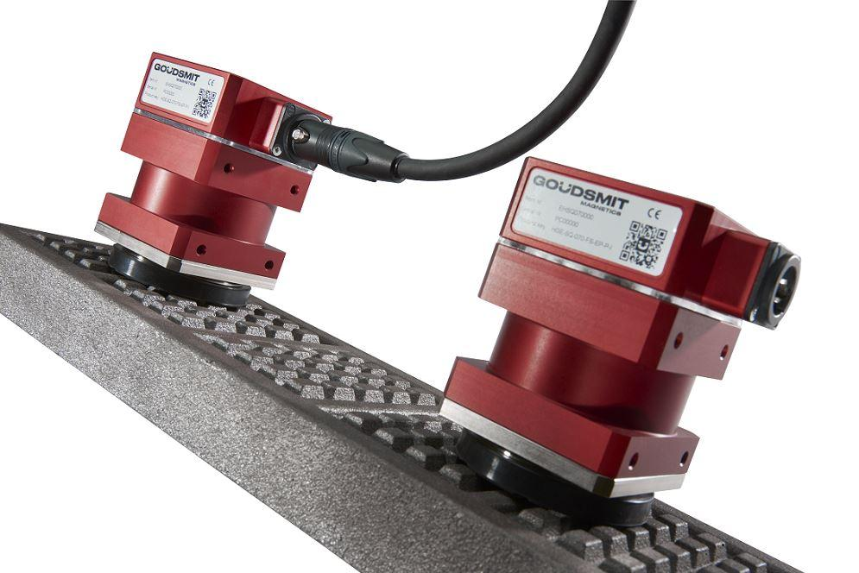
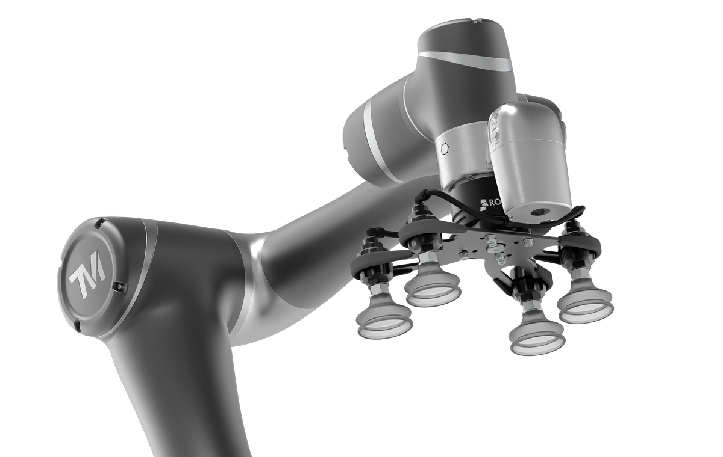
STATE OF THE ART
DESIGN
3D MODELING
EXPERIMENTAL PHASE
CLASSIFICATION
Actuation-based
Electric actuation
Magnetic actuation
Vacuum grippers
Configuration-based
Number of fingers
Shape of fingers
Figure 4: Electric gripper.
Figure 6: Magnetic gripper.
Figure 5: Vacuum gripper.
Stiffness-based
Rigid grippers
Soft grippers

Slide 7
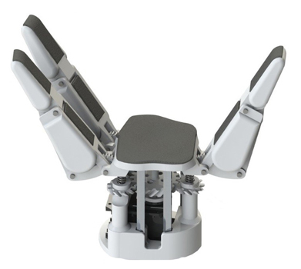
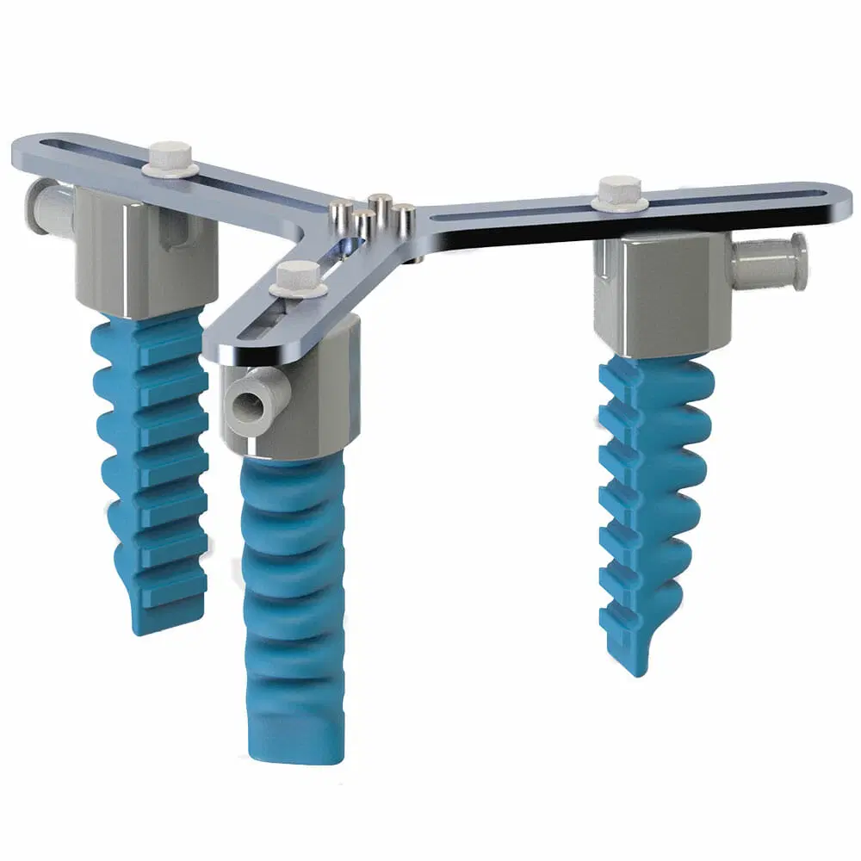
STATE OF THE ART
DESIGN
3D MODELING
EXPERIMENTAL PHASE
CLASSIFICATION
Actuation-based
Electric actuation
Magnetic actuation
Vacuum grippers
Stiffness-based
Rigid grippers
Soft grippers
Figure 7: Rigid gripper.
Figure 8: Soft gripper.
Application-based
Surgical applications
Assistive applications
Industrial applications

Slide 8
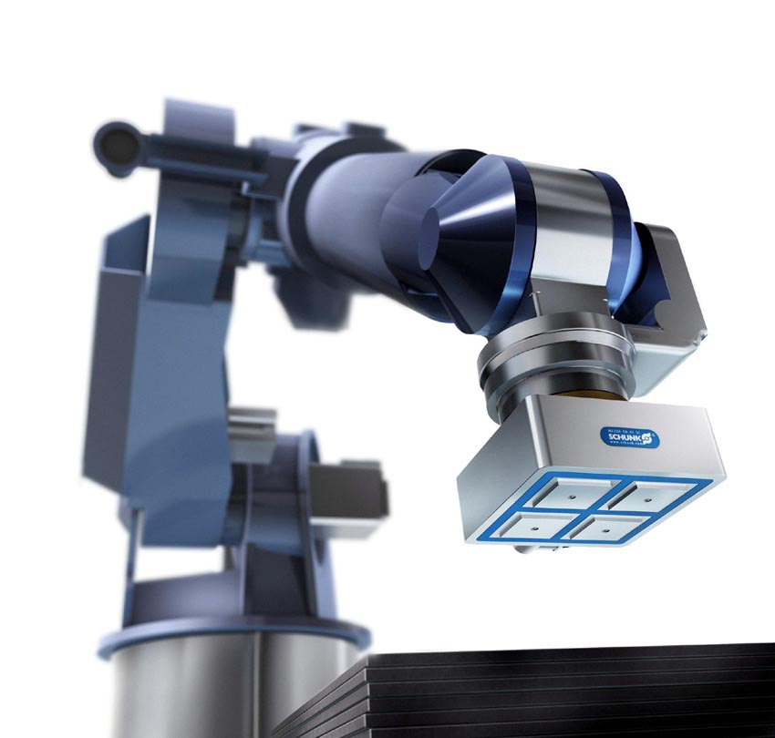
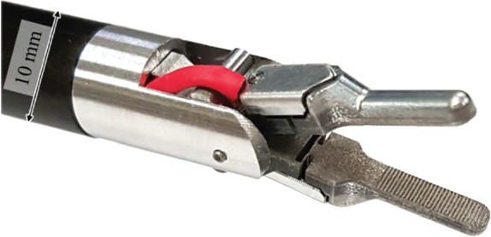
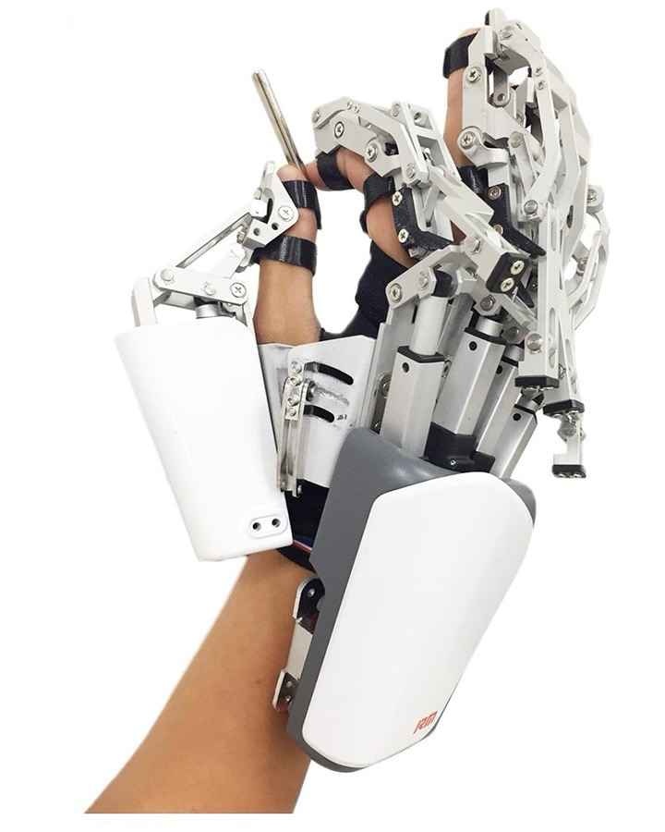
STATE OF THE ART
DESIGN
3D MODELING
EXPERIMENTAL PHASE
CLASSIFICATION
Application-based
Surgical applications
Assistive applications
Industrial applications
Figure 9: Gripper for surgical applications.
Figure 11: Gripper for industrial applications.
Figure 10: Gripper for assistive applications.
Stiffness-based
Rigid grippers
Soft grippers

Slide 9
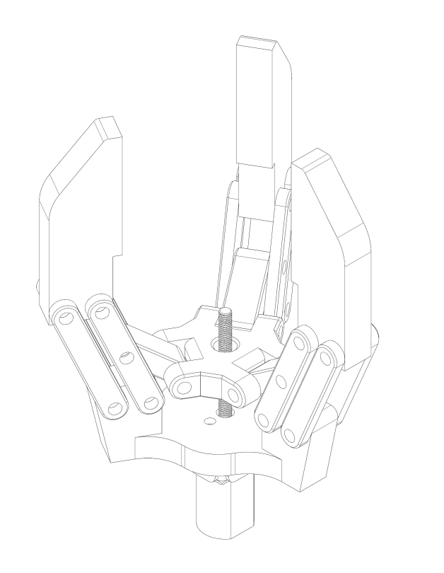
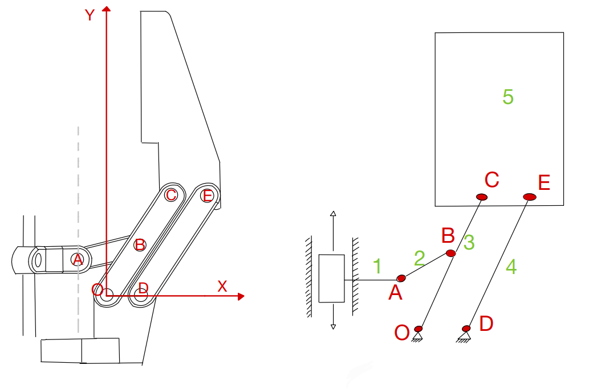
STATE OF THE ART
DESIGN
3D MODELING
EXPERIMENTAL PHASE
PARALLEL GRIPPER PRELIMINARY SKETCH
The first part of the gripper design process deals with a preliminary sketch that shows the main idea and components of the parallel gripper
Base part and DC motor case
Palm (elevator)
Connection rods
3 identical fingers equally spaced along a circumference

Slide 10
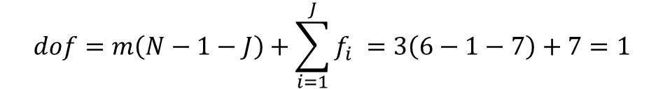
STATE OF THE ART
DESIGN
3D MODELING
EXPERIMENTAL PHASE
DEGREE OF FREEDOM ANALYSIS
GRÜBLER’S FORMULA
$$dof=m\left(N−1−J\right)+\sum_{i=1}^{J}{f_{i} =3\left(6−1−7\right)+7=1 }$$
$m$ = 6 for spatial bodies, 3 for planar
𝑚 = 6 for spatial bodies, 3 for planar
$N$ = number of bodies, including ground
𝑁 = number of bodies, including ground
$J$ = number of joints
𝐽 = number of joints
$f_{i}$ = degrees of freedom of the i-esim joint
𝑓_𝑖 = degrees of freedom of the i-esim joint

Slide 11
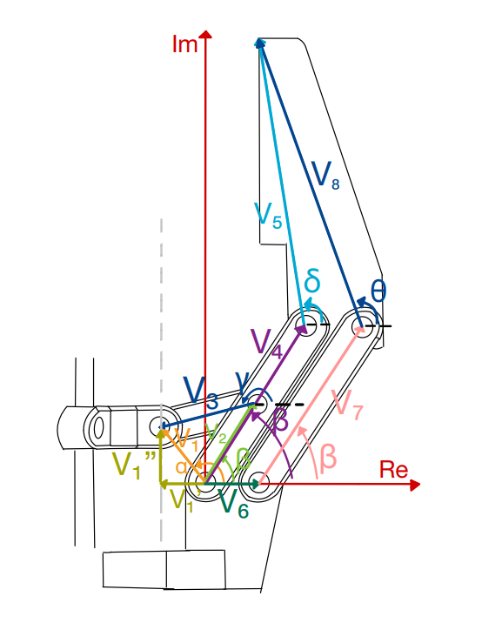
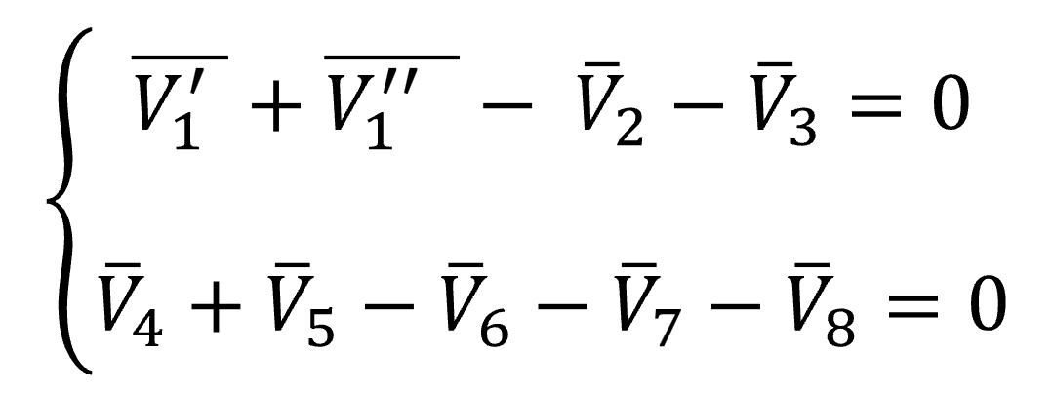

STATE OF THE ART
DESIGN
3D MODELING
EXPERIMENTAL PHASE
FINGER DISPLACEMENT ANALYSIS
CLOSING EQUATIONS METHOD
The mechanism is outlined through vectors expressed as complex numbers, so in terms of magnitude and phase. In this way, a non linear system of equations can be obtained, having a general understanding of the possible displacement of the mechanism.
$$\left\{\begin{matrix}V_{1}^{′}e^{−jπ}+V_{1}^{′′}e^{j\frac{π}{2}}−V_{2}e^{jβ}−V_{3}e^{jγ}=0 \\ V_{4}e^{jβ}+V_{5}^{jδ}−V_{6}e^{j0}−V_{7}e^{jβ}−V_{8}e^{jθ}=0\end{matrix}\right.$$

Slide 12
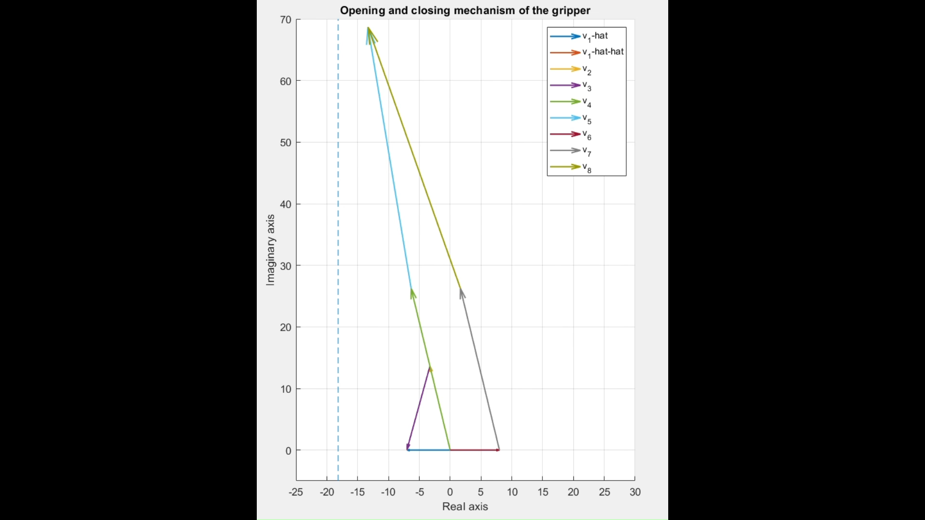

STATE OF THE ART
DESIGN
3D MODELING
EXPERIMENTAL PHASE
FINGER DISPLACEMENT ANALYSIS
CLOSING EQUATIONS METHOD
The mechanism is outlined through vectors expressed as complex numbers, so in terms of magnitude and phase. In this way, a non linear system of equations can be obtained, having a general understanding of the possible displacement of the mechanism.
$$\left\{\begin{matrix}V_{1}^{′}e^{−jπ}+V_{1}^{′′}e^{j\frac{π}{2}}−V_{2}e^{jβ}−V_{3}e^{jγ}=0 \\ V_{4}e^{jβ}+V_{5}^{jδ}−V_{6}e^{j0}−V_{7}e^{jβ}−V_{8}e^{jθ}=0\end{matrix}\right.$$

Slide 13
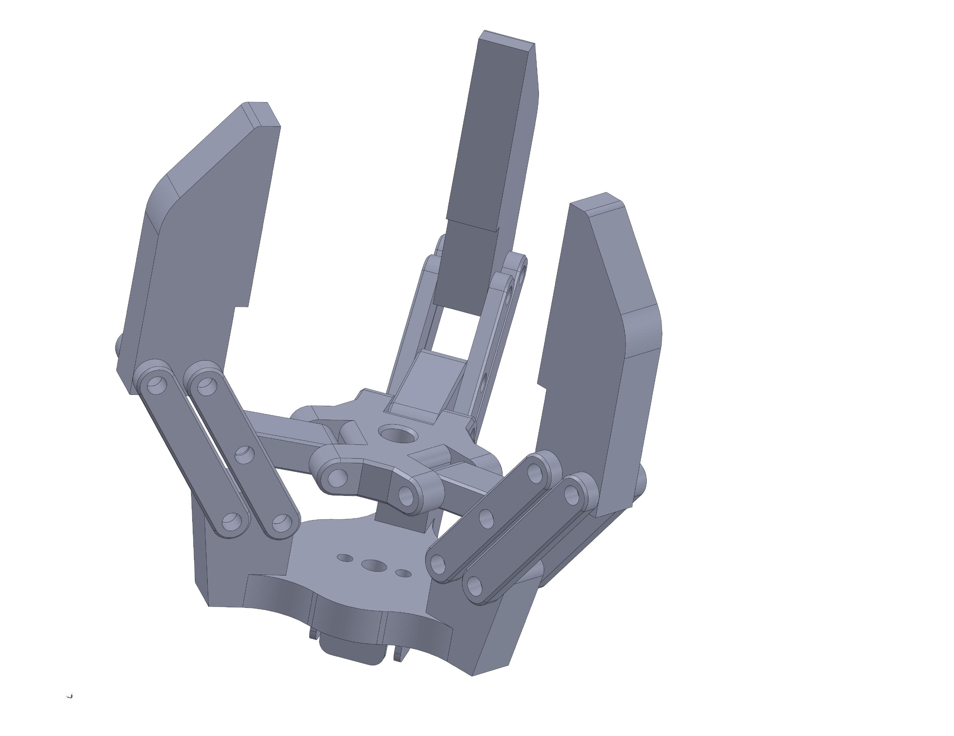
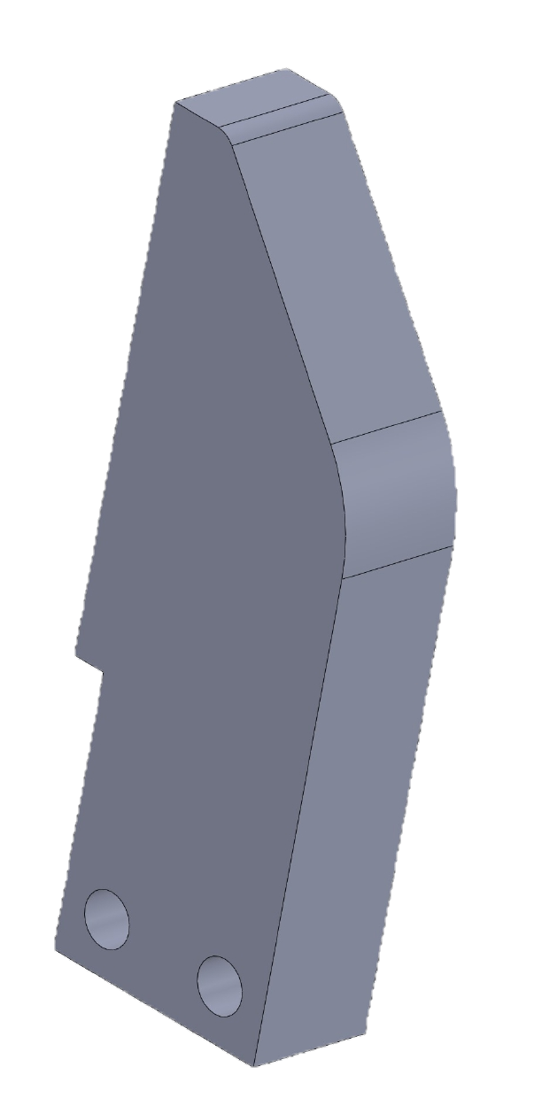
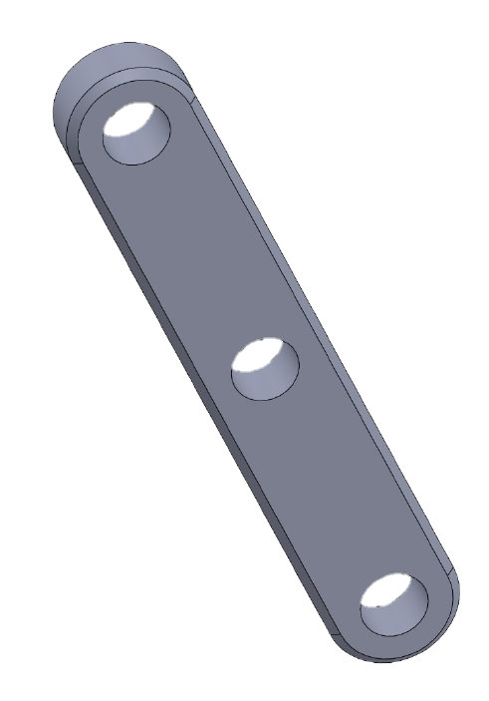
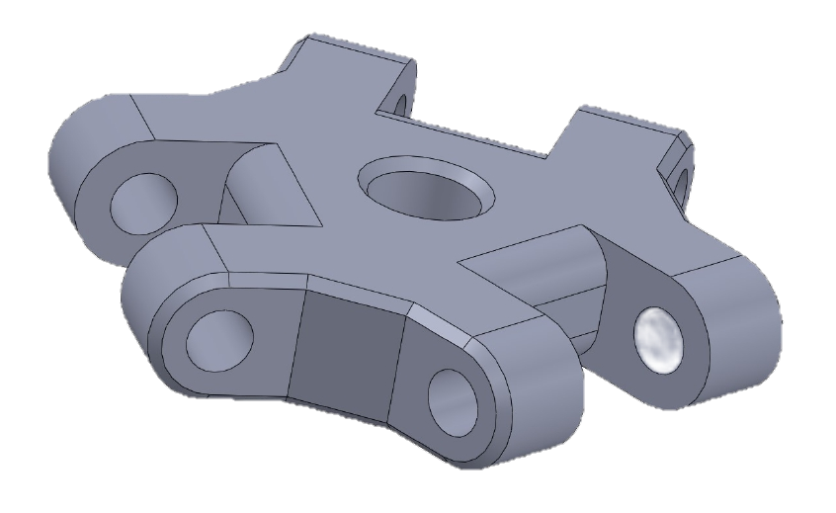
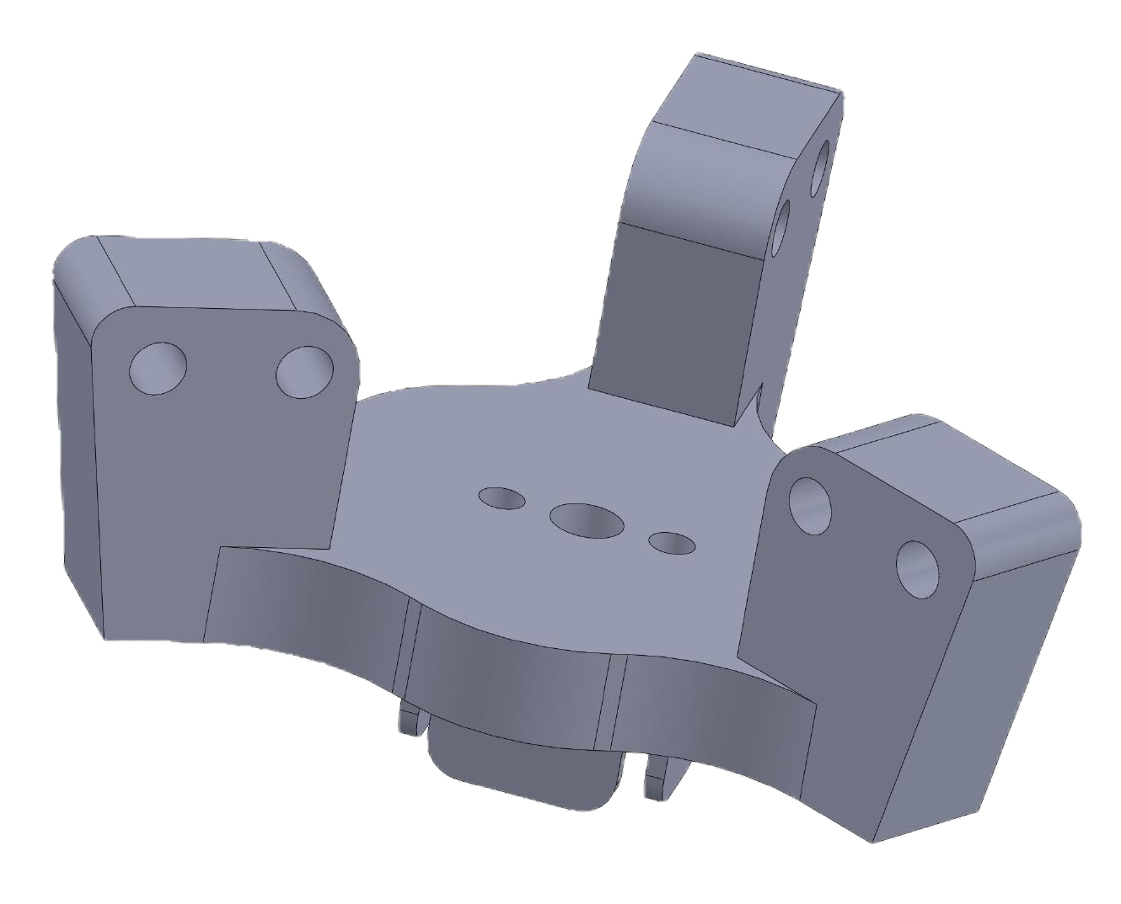
STATE OF THE ART
DESIGN
3D MODELING
EXPERIMENTAL PHASE
Connection rods
Base
Palm (elevator)
Fingers
Designed to reuse design sketches efficiently
It is the dissa part of the end-effector anchored to the robotic arm, and contains the electric motor
Palm-base distance determines aperture and closure of the end-effector. The threading allows linear movement.
These are the parts that come into contact with the external object and on which the gripping force is exerted

Slide 14
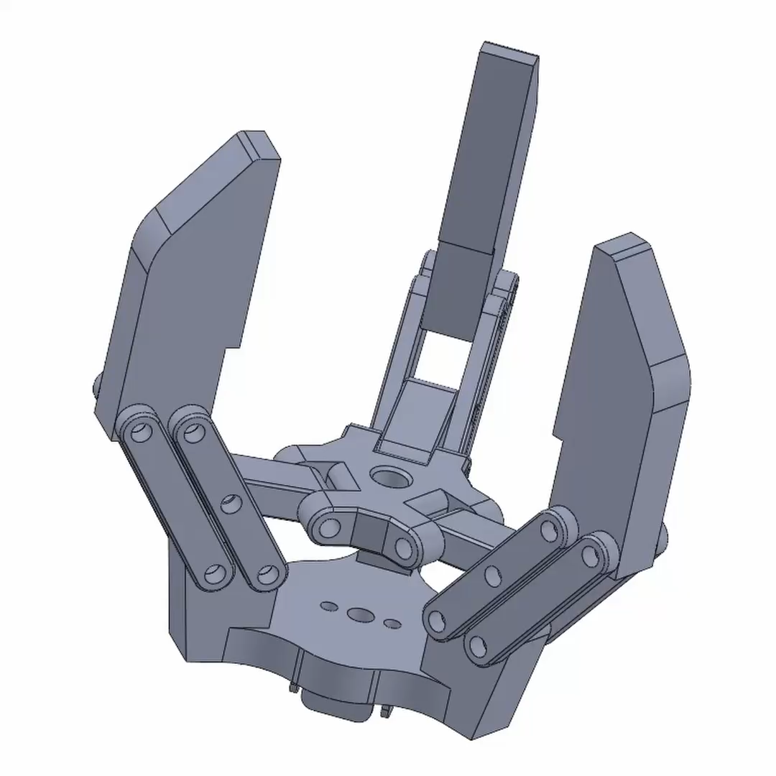
STATE OF THE ART
DESIGN
3D MODELING
EXPERIMENTAL PHASE
3D MODEL FINAL RESULT

Slide 15
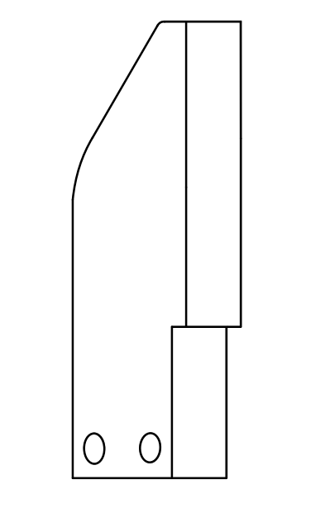
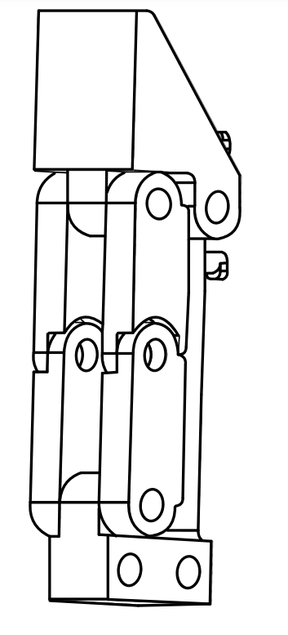
STATE OF THE ART
DESIGN
3D MODELING
EXPERIMENTAL PHASE
FROM PARALLEL TO ADAPTIVE
To switch to the adaptive version of the endeffector, one focuses on the phalanges without modifying the remaining parts not in contact with the grasped object. Mobile joints are introduced to form the fingers that can embrace the foreign body, which in turn are anchored to a fixed part and the tip that ends the phalanx.
Greater Flexibility
Secure Grip
Simplicity of Design

Slide 16
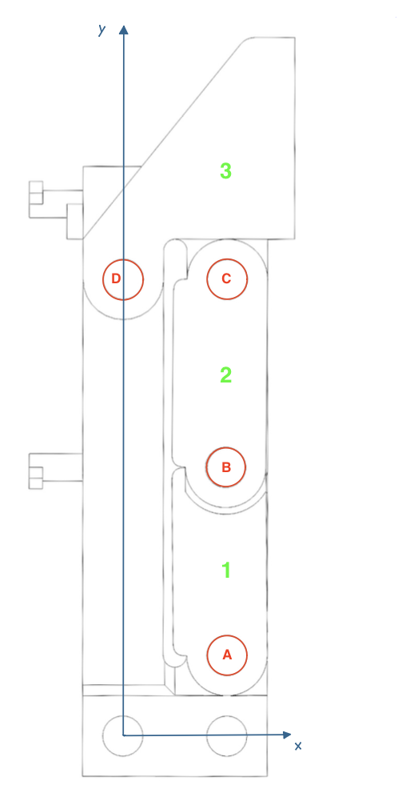
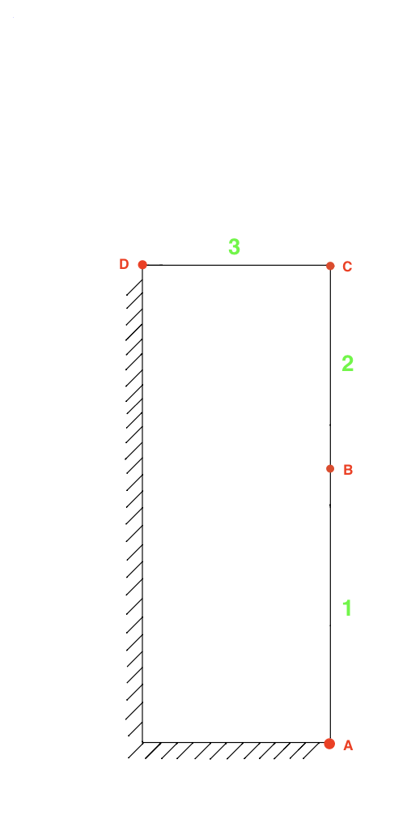
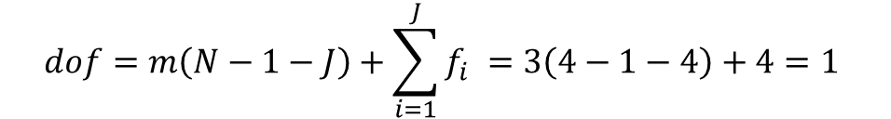
STATE OF THE ART
DESIGN
3D MODELING
EXPERIMENTAL PHASE
ADAPTIVE PHALANX DEGREES OF FREEDOM
On the left, a technical side view of the adaptive phalanx is shown, while on the right, a simplified schematic representation facilitates the calculation of its degrees of freedom. The phalanx is equipped with 4 revolute joints and consists of 3 bodies. Therefore, the degrees of freedom of the phalanx are:
$$dof=m\left(N−1−J\right)+\sum_{i=1}^{J}{f_{i} =3\left(4−1−4\right)+4=1 }$$

Slide 17
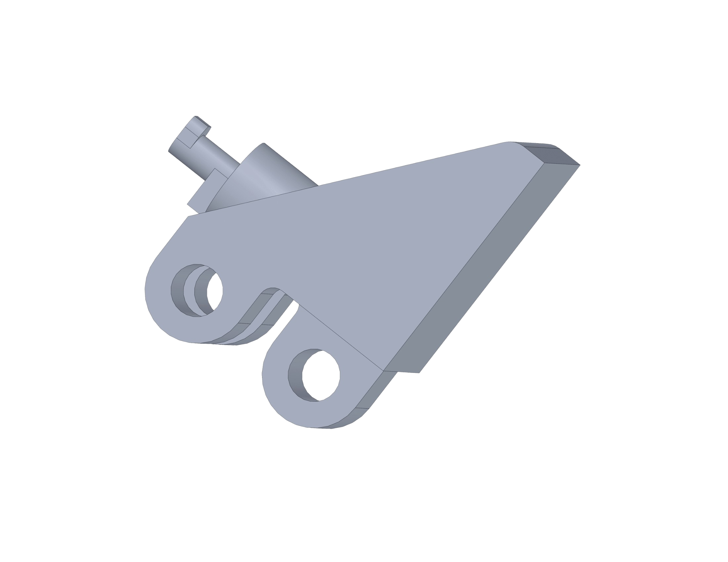
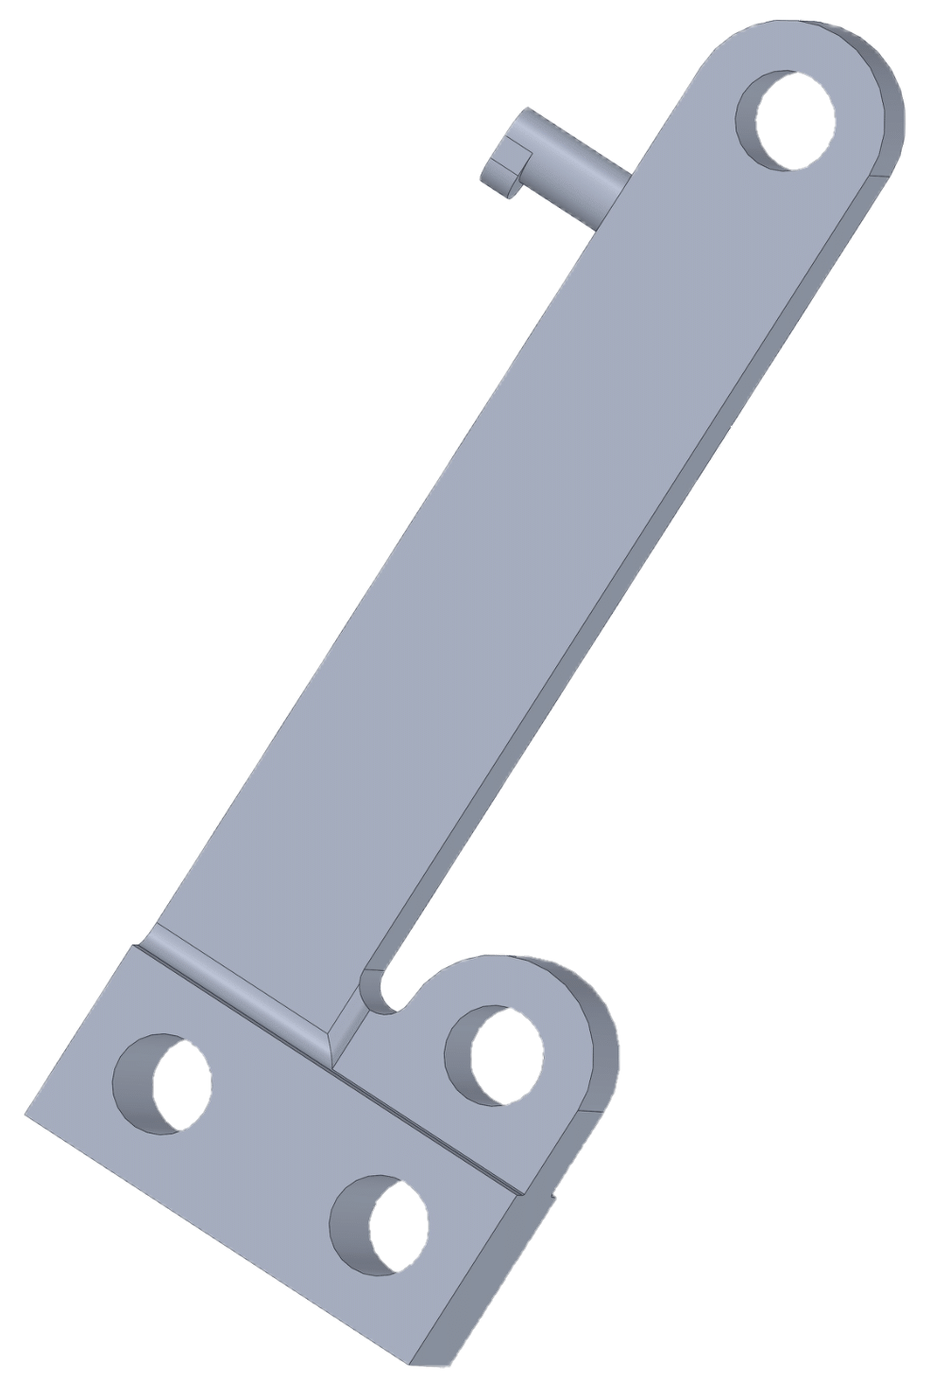
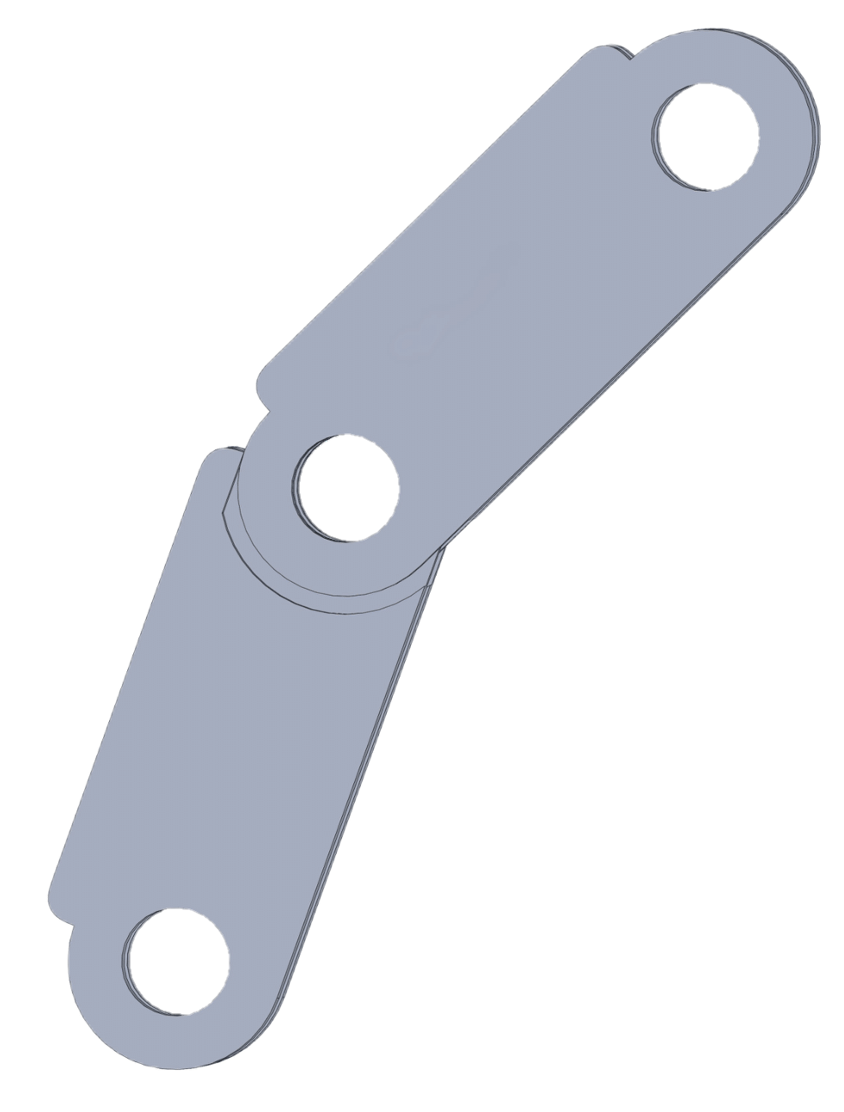
STATE OF THE ART
DESIGN
3D MODELING
EXPERIMENTAL PHASE
Fixed gripper stand
Moveable joints
Final gripper
It is the central support for the phalanx, provides the same connection to the remaining parts of the end-effector that had the parallel and has a peg for the spring
The component is designed to take advantage of redundancy. The clappers prevent rotation in the reverse direction
Provides the hook for the other end of the spring that allows the return of the initial conditions

Slide 18
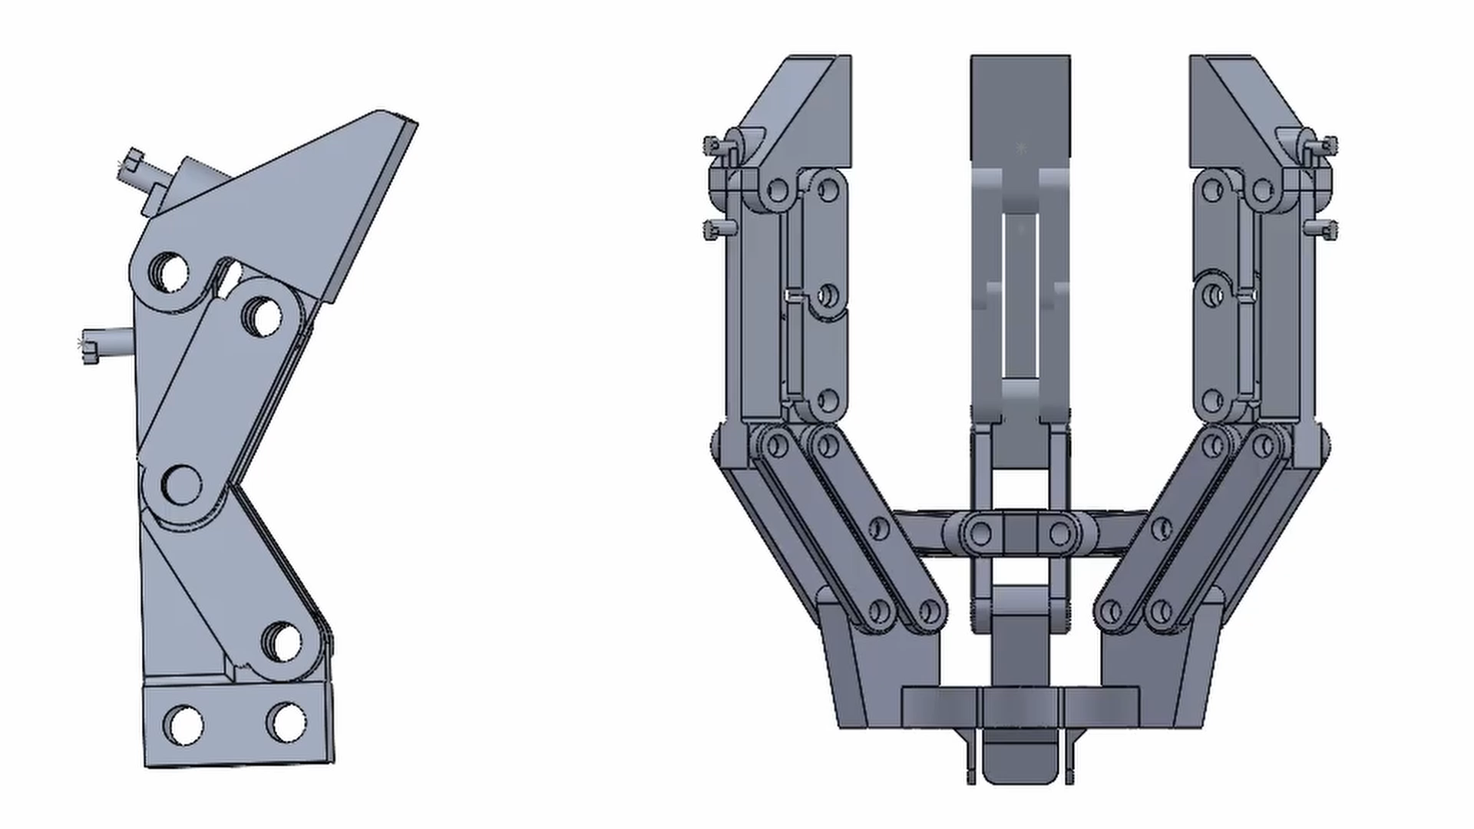
STATE OF THE ART
DESIGN
3D MODELING
EXPERIMENTAL PHASE
3D MODEL FINAL RESULT

Slide 19
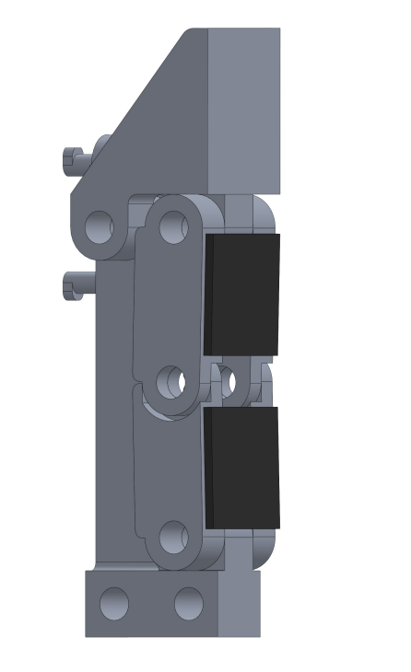
STATE OF THE ART
DESIGN
3D MODELING
EXPERIMENTAL PHASE
RUBBER PADS
In the experimental phase rubber pads were used. Their function is to connect the 2 upper phalanges and the 2 lower phalanges.
This allows for fewer contact points between the ball and gripper, making the simulation less computationally demanding and allowing more stable plot plots.

Slide 20
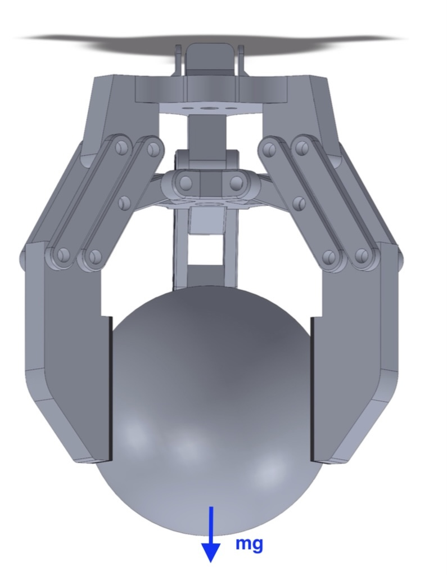
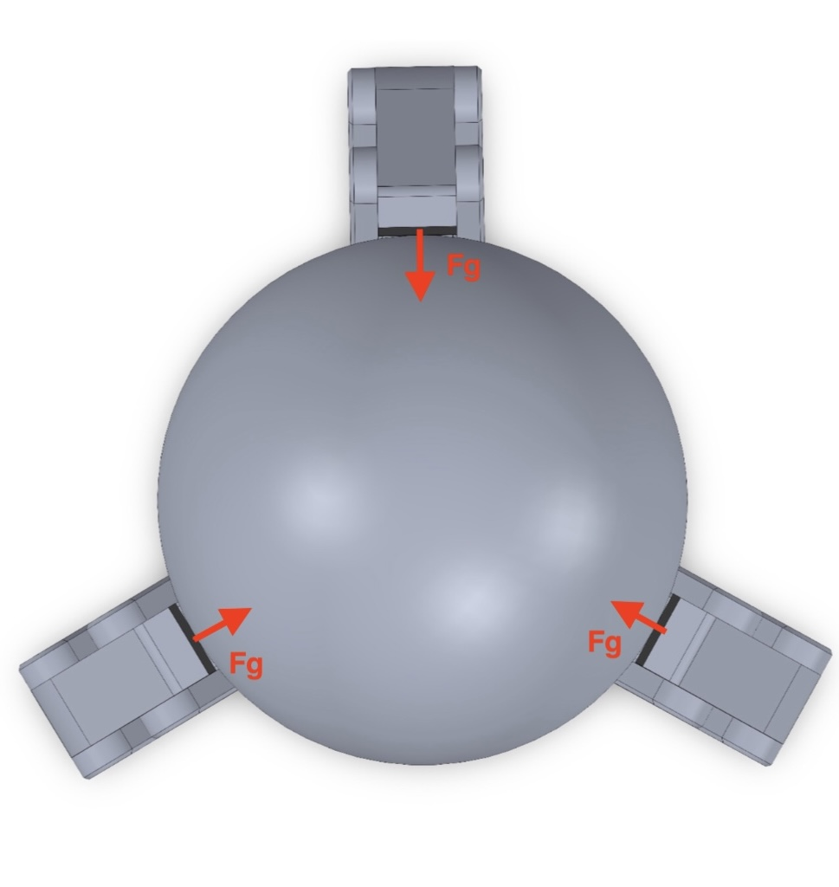
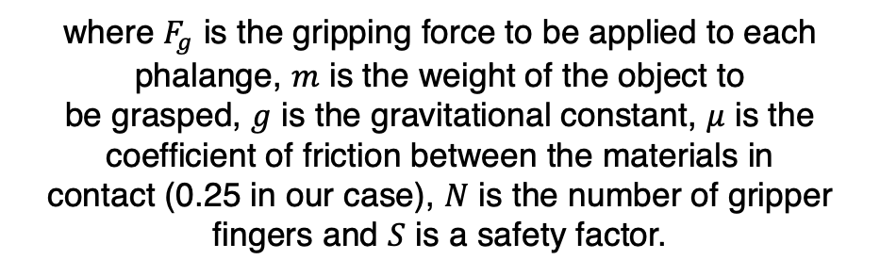
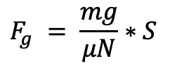
STATE OF THE ART
DESIGN
3D MODELING
EXPERIMENTAL PHASE
GRIPPING FORCE
The left side displays a front view of the parallel gripper while grasping a sphere. On the right side, a bottom view is provided.
The gripping force required to grasp the object on each phalange is:
$$F_{g} = \frac{mg}{μN}∗S$$
where $F_{g}$ is the gripping force to be applied to each phalange, $m$ is the weight of the object to
be grasped, $g$ is the gravitational constant, $μ$ is the coefficient of friction between the materials in
contact (0.25 in our case), $N$ is the number of gripper fingers and $S$ is a safety factor.

Slide 21
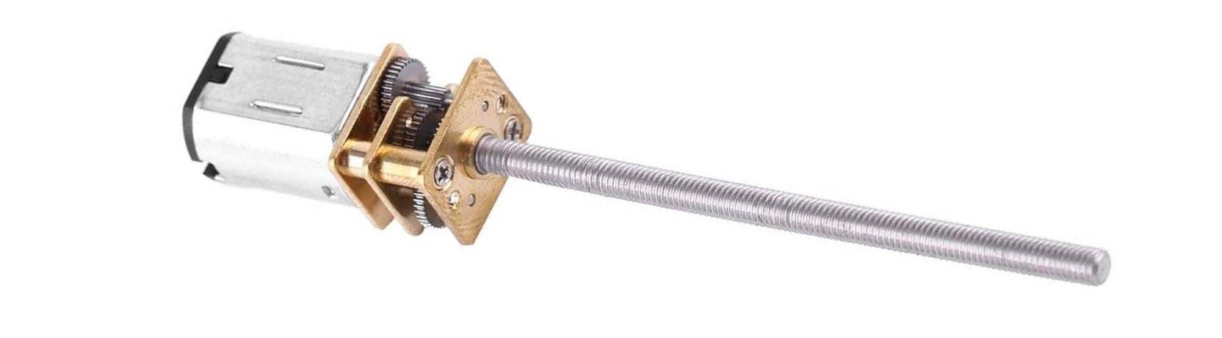
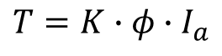
STATE OF THE ART
DESIGN
3D MODELING
EXPERIMENTAL PHASE
CHOICE OF DC MOTOR
The choice of motor is crucial since it determines the maximum gripping force applicable by the end-effector and also the closing and opening speed.
Among the various types, the DC motor is chosen, which, having a linear torque characteristic, makes it easy to deduce the force that can be obtained from the feed-forward construction parameters, as shown below:
$$T=K∙φ∙I_{a}$$
Figure 12: DC motor used in the experimental phase (available at the following link).

Slide 22
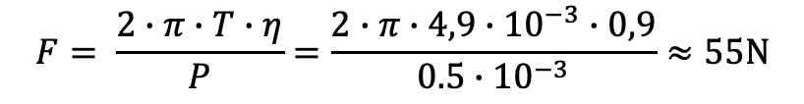

STATE OF THE ART
DESIGN
3D MODELING
EXPERIMENTAL PHASE
CHOICE OF DC MOTOR
It is also necessary to transform the rotary motion of our motor into a linear motion suitable for the movement of the palm in our end-effector.
From the motor datasheet, having set the appropriate power values, the corresponding torque can be derived. For simulation purposes we use the following formula to derive the force exerted on the palm.
F : resultant force placed on the palm (N)
T : torque produced by the motor (4.9 N $∙$mm)
$$F= \frac{2∙π∙T∙η}{P}=\frac{2∙π∙4,9∙{10}^{−3}∙0,9}{0.5∙{10}^{−3}}≈55N$$
$η$ : efficiency (0.9)
P: pitch of the threaded rod (0.5 mm)

Slide 23
STATE OF THE ART
DESIGN
3D MODELING
EXPERIMENTAL PHASE
CHOICE OF DC MOTOR
To calculate the linear velocity of the palm displacement we can use the following formula where ω is the angular velocity and p is the pitch of the threaded rod. Knowing that the excursion made by the part we can calculate the time taken for the complete opening and closing of the endeffector.
$$v=ω∙p=100.531∙0.5∙{10}^{−3}≈50 mm/s$$

Slide 24
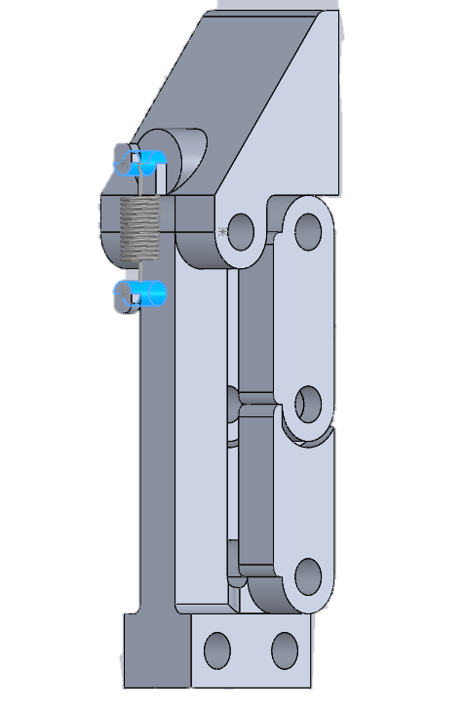
STATE OF THE ART
DESIGN
3D MODELING
EXPERIMENTAL PHASE
CHOICE OF SPRING
Each finger of the adaptive configuration requires a spring that allows the finger to adapt correctly to the object to be grasped, also ensuring the return to the vertical position of the finger when the palm of the gripper is fully raised.
Type of spring
Adaptability achievable
Availability on the market

Slide 25
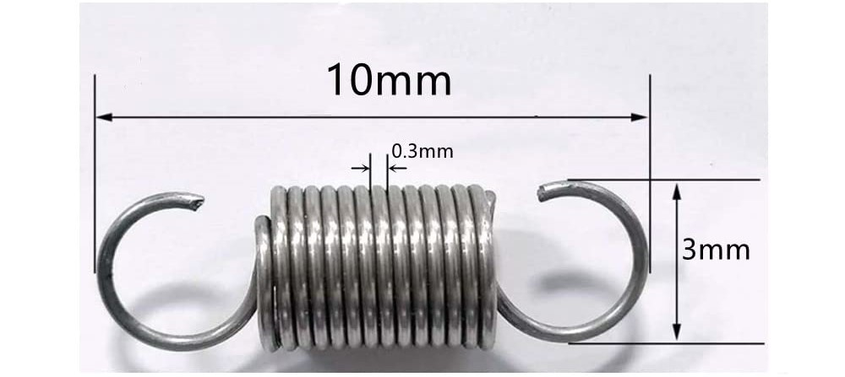

STATE OF THE ART
DESIGN
3D MODELING
EXPERIMENTAL PHASE
CHOICE OF SPRING
To carry out the simulations on SolidWorks Motion, the elastic constant and the free length of the spring must be known.
$$k= \frac{Gd^{4}}{8nD^{3}}$$
Figure 13: Spring used in the experimental phase (available at the following link).
Richard G. Budynas and Keith Nisbett. Shigley’s Mechanical Engineering Design. McGraw-Hill, 2011, p. 520.

Slide 26

STATE OF THE ART
DESIGN
3D MODELING
EXPERIMENTAL PHASE
CHOICE OF SPRING
To carry out the simulations on SolidWorks Motion, the elastic constant and the free length of the spring must be known.
G : spring material stiffness module (79 GPa)
d : diameter of the spring wire (0.3 mm)
$$k= \frac{Gd^{4}}{8nD^{3}}$$
n : the number of active coils (14)
D is the average diameter of the spring (2.7 mm)
Richard G. Budynas and Keith Nisbett. Shigley’s Mechanical Engineering Design. McGraw-Hill, 2011, p. 520.

Slide 27
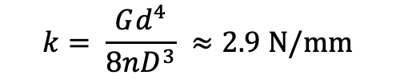
STATE OF THE ART
DESIGN
3D MODELING
EXPERIMENTAL PHASE
CHOICE OF SPRING
To carry out the simulations on SolidWorks Motion, the elastic constant and the free length of the spring must be known.
$$k= \frac{Gd^{4}}{8nD^{3}} ≈2.9 N/mm$$
Richard G. Budynas and Keith Nisbett. Shigley’s Mechanical Engineering Design. McGraw-Hill, 2011, p. 520.

Slide 28
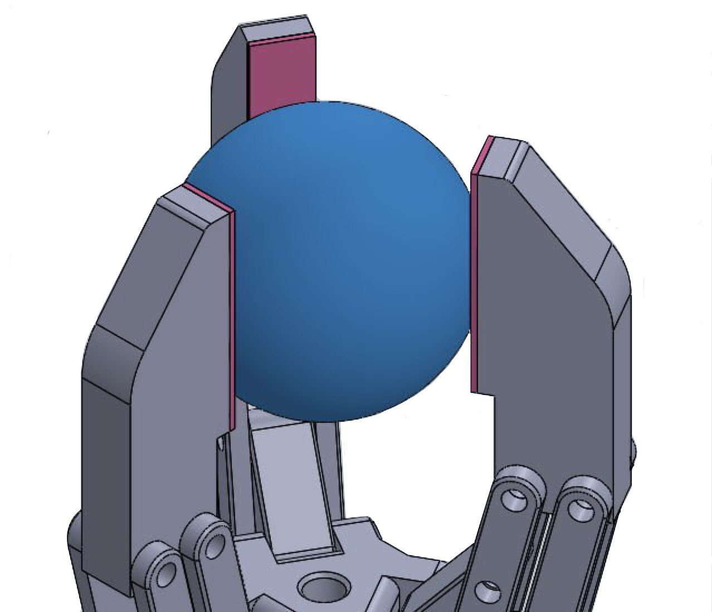
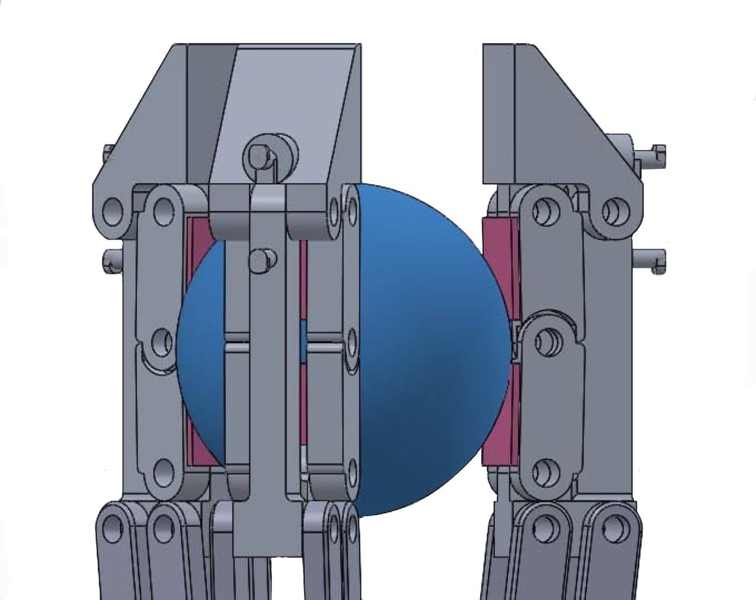
STATE OF THE ART
DESIGN
3D MODELING
EXPERIMENTAL PHASE
SIMULATION PARAMETERS’ CONFIGURATION
To carry out the simulations on SolidWorks Motion the simulation parameters must be properly set. This allows to have complete and reliable results, which consider the real operating situations.
Contact between bodies
Linear force applied to the palm
Force of gravity
Linear spring parameters

Slide 29
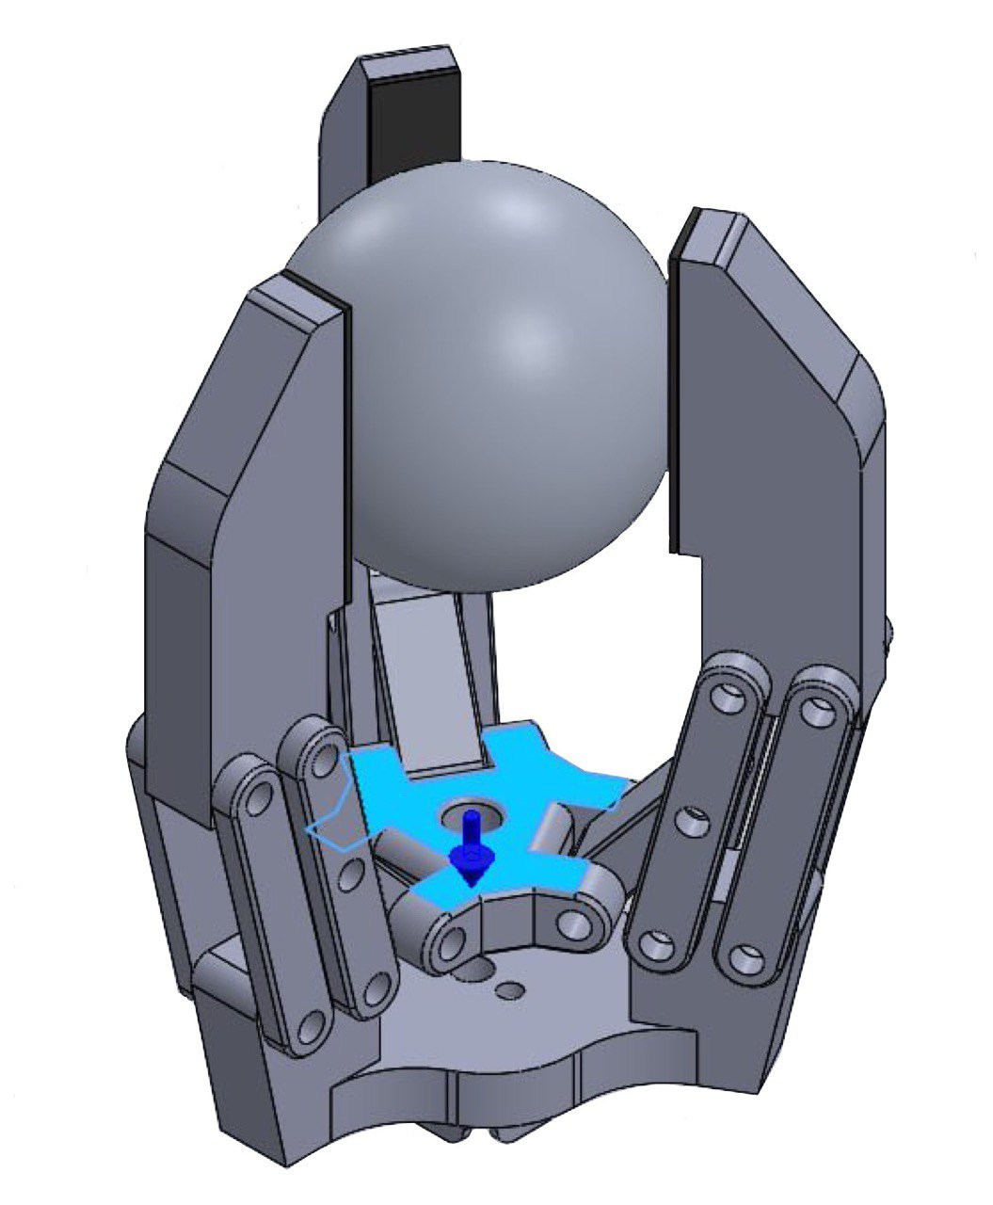
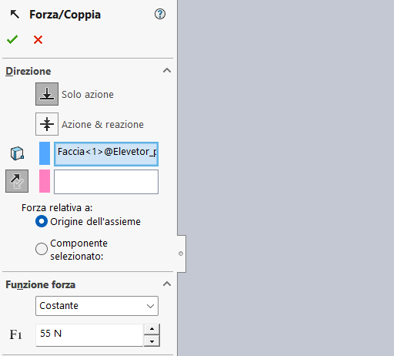
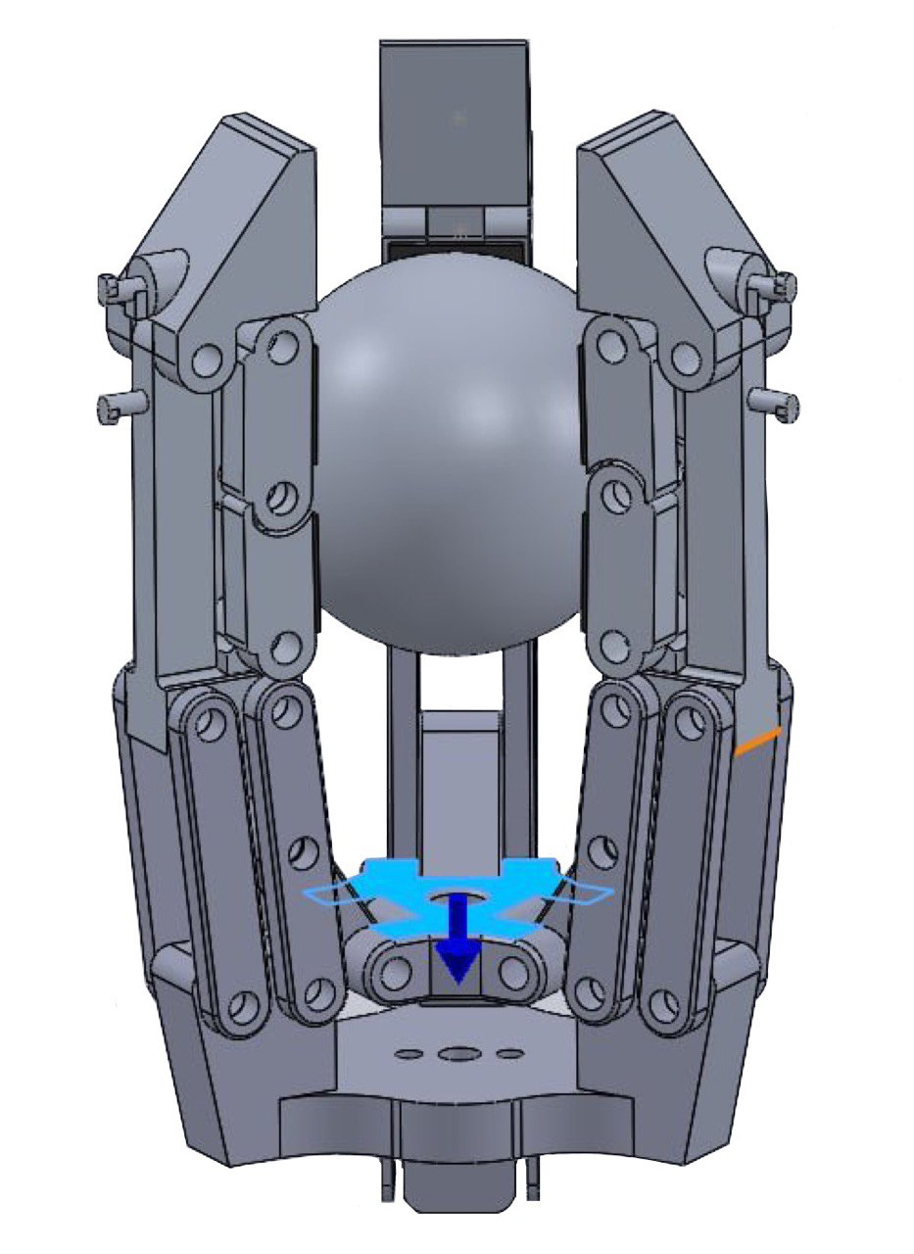
STATE OF THE ART
DESIGN
3D MODELING
EXPERIMENTAL PHASE
SIMULATION PARAMETERS’ CONFIGURATION
Contact between bodies

Slide 30

STATE OF THE ART
DESIGN
3D MODELING
EXPERIMENTAL PHASE
SIMULATION PARAMETERS’ CONFIGURATION
Contact between bodies
Linear force applied to the palm

Slide 31


STATE OF THE ART
DESIGN
3D MODELING
EXPERIMENTAL PHASE
SIMULATION PARAMETERS’ CONFIGURATION
Force of gravity
Linear force applied to the palm
The force of gravity is set in such a way that its direction pushes away the object to be grasped from the palm. This is because, for obvious reasons of design and space size, the gripper grabs objects from above.
$$g$$

Slide 32
STATE OF THE ART
DESIGN
3D MODELING
EXPERIMENTAL PHASE
SIMULATION PARAMETERS’ CONFIGURATION
Linear spring parameters
Force of gravity
exponent of spring force expression
spring elastic constant
Free length
Visualization options

Slide 33
STATE OF THE ART
DESIGN
3D MODELING
EXPERIMENTAL PHASE
SIMULATIONS
The tests were performed to compare the contact force generated by a gripper in both parallel and adaptive gripper configurations. The object used for the gripping tests is a sphere made of aluminum alloy DIN 3.0205 (EN-AW 1200) with three different radius values: 26, 22, and 18 millimeters. For a radius of 26 mm, the sphere’s mass is 200 g; for a radius of 22 mm, the mass is approximately 120 g; and for a radius of 18 mm, the mass is 60 g.
Parallel gripper with large sphere
Adaptive gripper with large sphere
Parallel gripper with medium sphere
Adaptive gripper with medium sphere
Parallel gripper with small sphere
Adaptive gripper with small sphere

Slide 34


STATE OF THE ART
DESIGN
3D MODELING
EXPERIMENTAL PHASE
SIMULATIONS
Parallel gripper with large sphere
Contact Force $≈22N$
Figure 13: Contact force between the phalanges of the parallel gripper and the large sphere.

Slide 35


STATE OF THE ART
DESIGN
3D MODELING
EXPERIMENTAL PHASE
SIMULATIONS
Parallel gripper with medium sphere
Parallel gripper with large sphere
Contact Force $≈9 N$
Figure 14: Contact force between the phalanges of the parallel gripper and the medium sphere.

Slide 36


STATE OF THE ART
DESIGN
3D MODELING
EXPERIMENTAL PHASE
SIMULATIONS
Parallel gripper with small sphere
Parallel gripper with medium sphere
Contact Force $≈6 N$
Figure 15: Contact force between the phalanges of the parallel gripper and the small sphere.

Slide 37



STATE OF THE ART
DESIGN
3D MODELING
EXPERIMENTAL PHASE
SIMULATIONS
Adaptive gripper with large sphere
Parallel gripper with small sphere
Contact Force of the upper phalanx $≈5.5 N$
Contact Force of the lower phalanx $≈3.5 N$
Figure 16: Contact force between the phalanges of the adaptive gripper and the large sphere.

Slide 38



STATE OF THE ART
DESIGN
3D MODELING
EXPERIMENTAL PHASE
SIMULATIONS
Adaptive gripper with medium sphere
Adaptive gripper with large sphere
Contact Force of the upper phalanx $≈4 N$
Contact Force of the lower phalanx $≈2.2 N$
Figure 17: Contact force between the phalanges of the adaptive gripper and the medium sphere.

Slide 39



STATE OF THE ART
DESIGN
3D MODELING
EXPERIMENTAL PHASE
SIMULATIONS
Adaptive gripper with small sphere
Adaptive gripper with medium sphere
Contact Force of the upper phalanx $≈3 N$
Contact Force of the lower phalanx $≈2 N$
Figure 18: Contact force between the phalanges of the adaptive gripper and the small sphere.

Slide 40
STATE OF THE ART
DESIGN
3D MODELING
EXPERIMENTAL PHASE
SIMULATIONS - SUMMARY
Parallel Gripper
 | LARGE SPHERE | MEDIUM SPHERE | SMALL SPHERE
Contact force | 22 N | 9 N | 6 N
Minimum gripping force required | 2.6 N | 1.6 N | 0.8 N
Adaptive Gripper
 | LARGE SPHERE | MEDIUM SPHERE | SMALL SPHERE
Contact Force of the upper phalanx | 5.5 N | 4 N | 3 N
Contact Force of the lower phalanx | 3.5 N | 2.2 N | 2 N

Slide 41
CONCLUSIONS
In this study, we analyzed and compared the performance of a parallel gripper and an adaptive gripper with the aim of evaluating their effectiveness in object manipulation. The simulations conducted highlighted significant differences between the two configurations.
ADVANTAGES OF THE PARALLEL GRIPPER | ADVANTAGES OF THE ADAPTIVE GRIPPER
Greater concentrated gripping force | Even distribution of forces
Lower production costs | Adaptability to irregularly shaped objects
Simplicity in design | Reduced risk of damaging delicate objects
As future developments for this project, the following objectives are planned:
Finite Element Method analysis
3D printing of the prototype
Experimental validation

Slide 42

Thanks for your attention

